Slide 1

Mini Project on
Hate Speech Detection
Under Mentorship of
Dr. Surendra Kumar Shukla
NAME- T Rishita Reddy UNIVERSITY ROLL NO.- 2017081
SECTION- I CLASS ROLL-47

Slide 2


Table of Content
12
3
4
Introduction and
problem statement
Methodology
Results and discussion
Conclusion and Future Work

Slide 3


INTRODUCTION
The term ‘hate speech’ was formally defined as ‘any communication that disparages a person or a group on the basis of some characteristics (to be referred to as types of hate or hate classes) such as race, colour, ethnicity, gender, sexual orientation, nationality, religion, or other characteristics. Due to increasing growth of social media like twitter, Facebook etc. It has become easier to make hateful comments, speeches and hate based activities. Hate speech detection model divides the content into hate and non-hate and thus detects the hateful or offensive content.

Slide 4

Problem Statement
The problem statement of our work is to detect hate speech from all content on twitter, classifying whether it is ‘hate speech’, ‘offensive’ or ‘neither’. If someone uses a hateful comment or offensive word, we can detect it using decision trees algorithm. Decision trees algorithm is most powerful tool for classification and prediction. We extracted data from Kaggle and made our own dataset.
We used multiple tools to make our project. Some of them are as follows:
-> Spyder
-> Google colab
->python libraries including numpy, pandas, nltk, re and sklearn.

Slide 5


METHODOLOGY
Data Collection- We collected data from Kaggle, extracted data along with our own additions, made our own dataset.
Tools and setup for our project- We will install required software and libraries as told in introduction above.
In making of our project, following methods will take place:
1) Setting up environment- The first step to develop or project is to install Jupyter notebook in our system.
2) Understanding the data- We have downloaded our data from Kaggle that uses Twitter database. We classified our data into ‘Hate speech’ , ‘Offensive’ and ‘Neither’. We used 7 columns in our dataset:
Ø index- stores index
Ø count- counts number of users who coded each tweet.
Ø hatespeech- number of users who suggested it to be hate speech
Ø offensivespeech- number of users who suggested it to be offensive content.
Ø neither- number of users who suggested it to be neither hate nor offensive.
Ø class- It consist of label in which we denoted 0 to ‘Hate speech’, 1 to ‘Offensive’ and 2 to ‘Neither’.

Slide 6



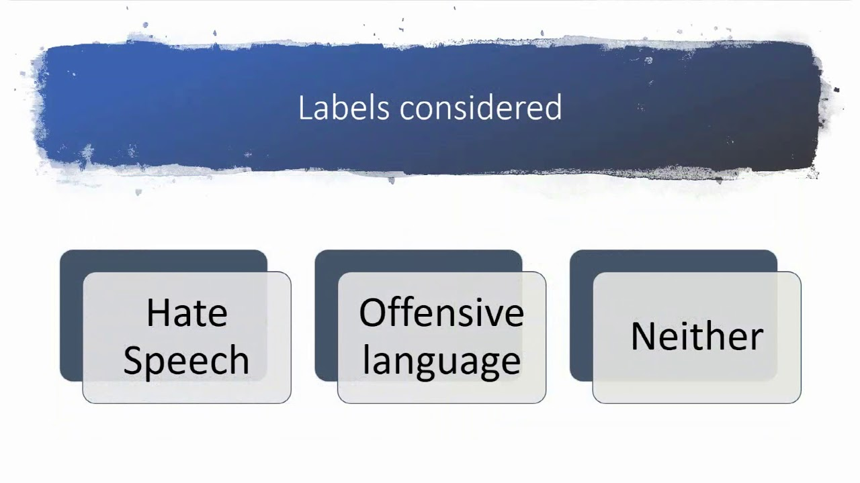
Ø column- This column consists of tweet texts.
3) Importing the libraries- Some of the libraries used in our project are pandas, numpy, nltk, re and sklearn. After importing libraries, we will load the data.
4) Preprocessing data- We will preprocess the data and make it suitable for our model. We used two Natural Language Processing terms:
Ø Stopword- They are useless words that are not used in the classification like conjunctions, punctuation etc.
Ø Stemmer- They are the root words and also their variants.
5) Splitting data- We will split our data into training and testing.
6) Building Model- After separating data, we will use decision trees to classify. Decision trees is supervised machine learning that uses set of principles to make a judgement.
7) Evaluating the results- In this step, we predict the accuracy of our machine learning model. Our model is approximately 88.89%.

Slide 7


Load Data
Steps
Preprocessing
Splitting Data
Build Model
Predicting Accuracy & result

Slide 8


RESULT AND DISCUSSION
By creating Hate speech detection model, we are able to classify given content into ‘Hate speech’, ‘Offensive’ or ‘neither’. Thus, with help of our model we can control hateful content on web, offensive comments and cyberbullying. In today’s times where social media has gained popularity and so does the bullying on web due to easier anonymity and access to post anything on internet.

Slide 9


CONCLUSION AND FUTURE WORK
As hate speech has become a big problem in our society, the need for automated speech detection has become more important.Most of social media platforms like Twitter, Facebook, Instagram are taking effective counter measures but still there is need for more research in this area. Recent works has shown that user characteristics such as their vocabulary, overall sentiment in their tweets, and network status can be useful predictors for abusive content.
The future of this study is in expansion of survey in global languages like European and American English. Also, more work should be done in various country’s languages NLP. Despite the challenges, there is need for more research on this problem, both technical and practical matters.

Slide 10





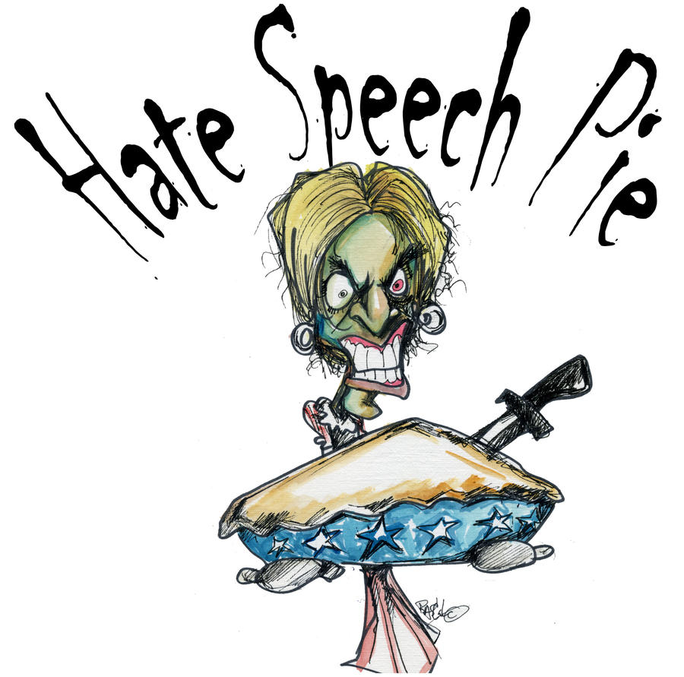
THANK YOU!!

